Slide 1
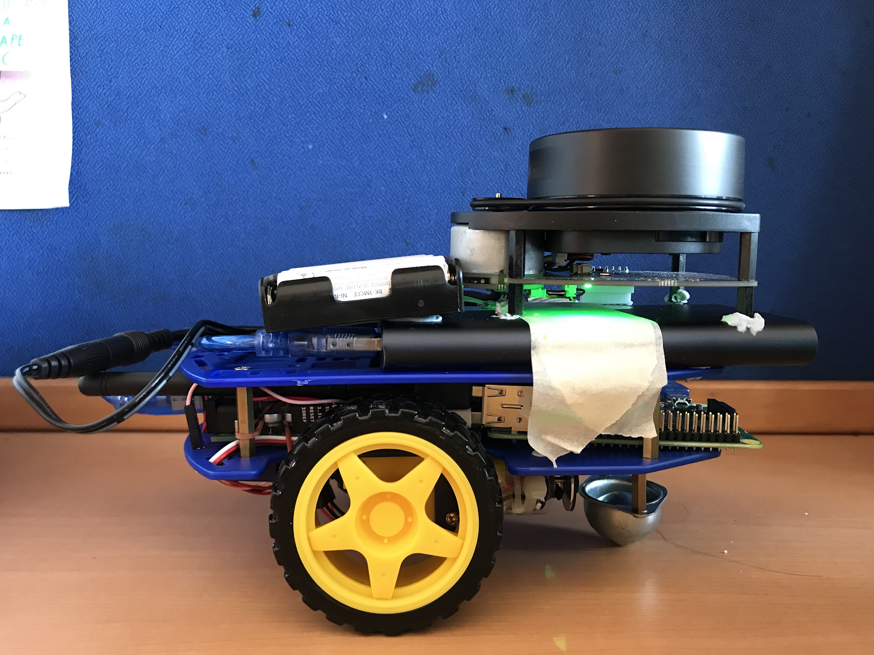
Batteries and portable charger
LIDAR unit
Raspberry Pi
Arduino
Motor and encoder

Slide 2
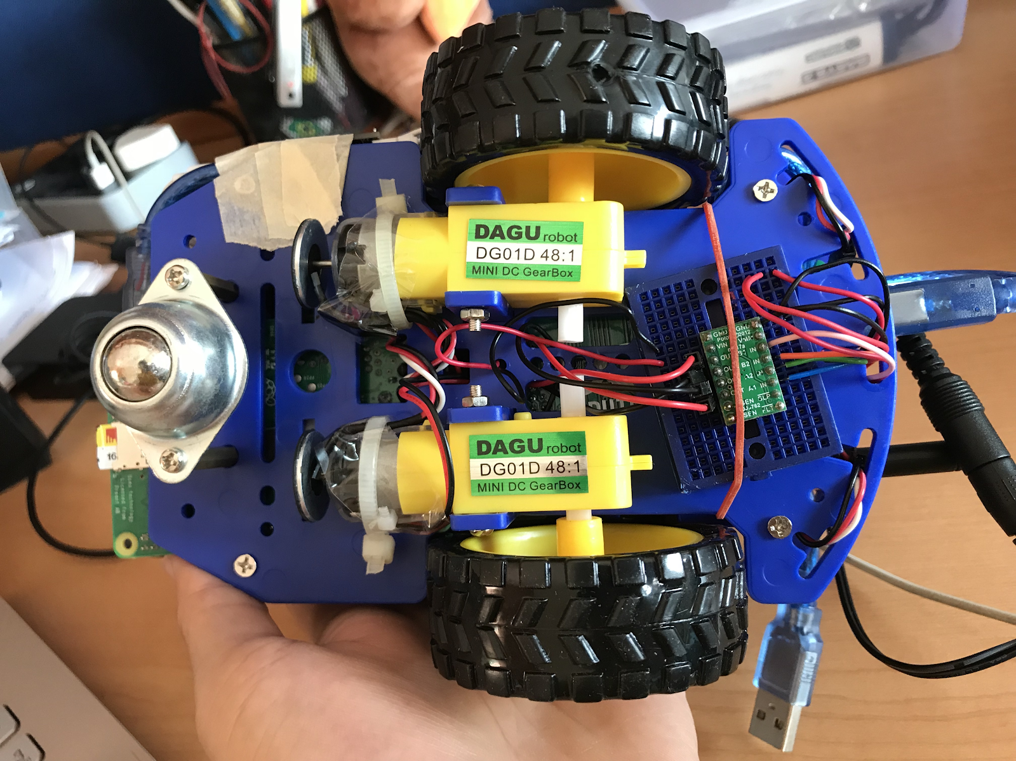
Motor
Encoder
Breadboard with
Motor controller
Magnet

Slide 3
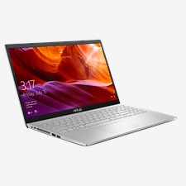
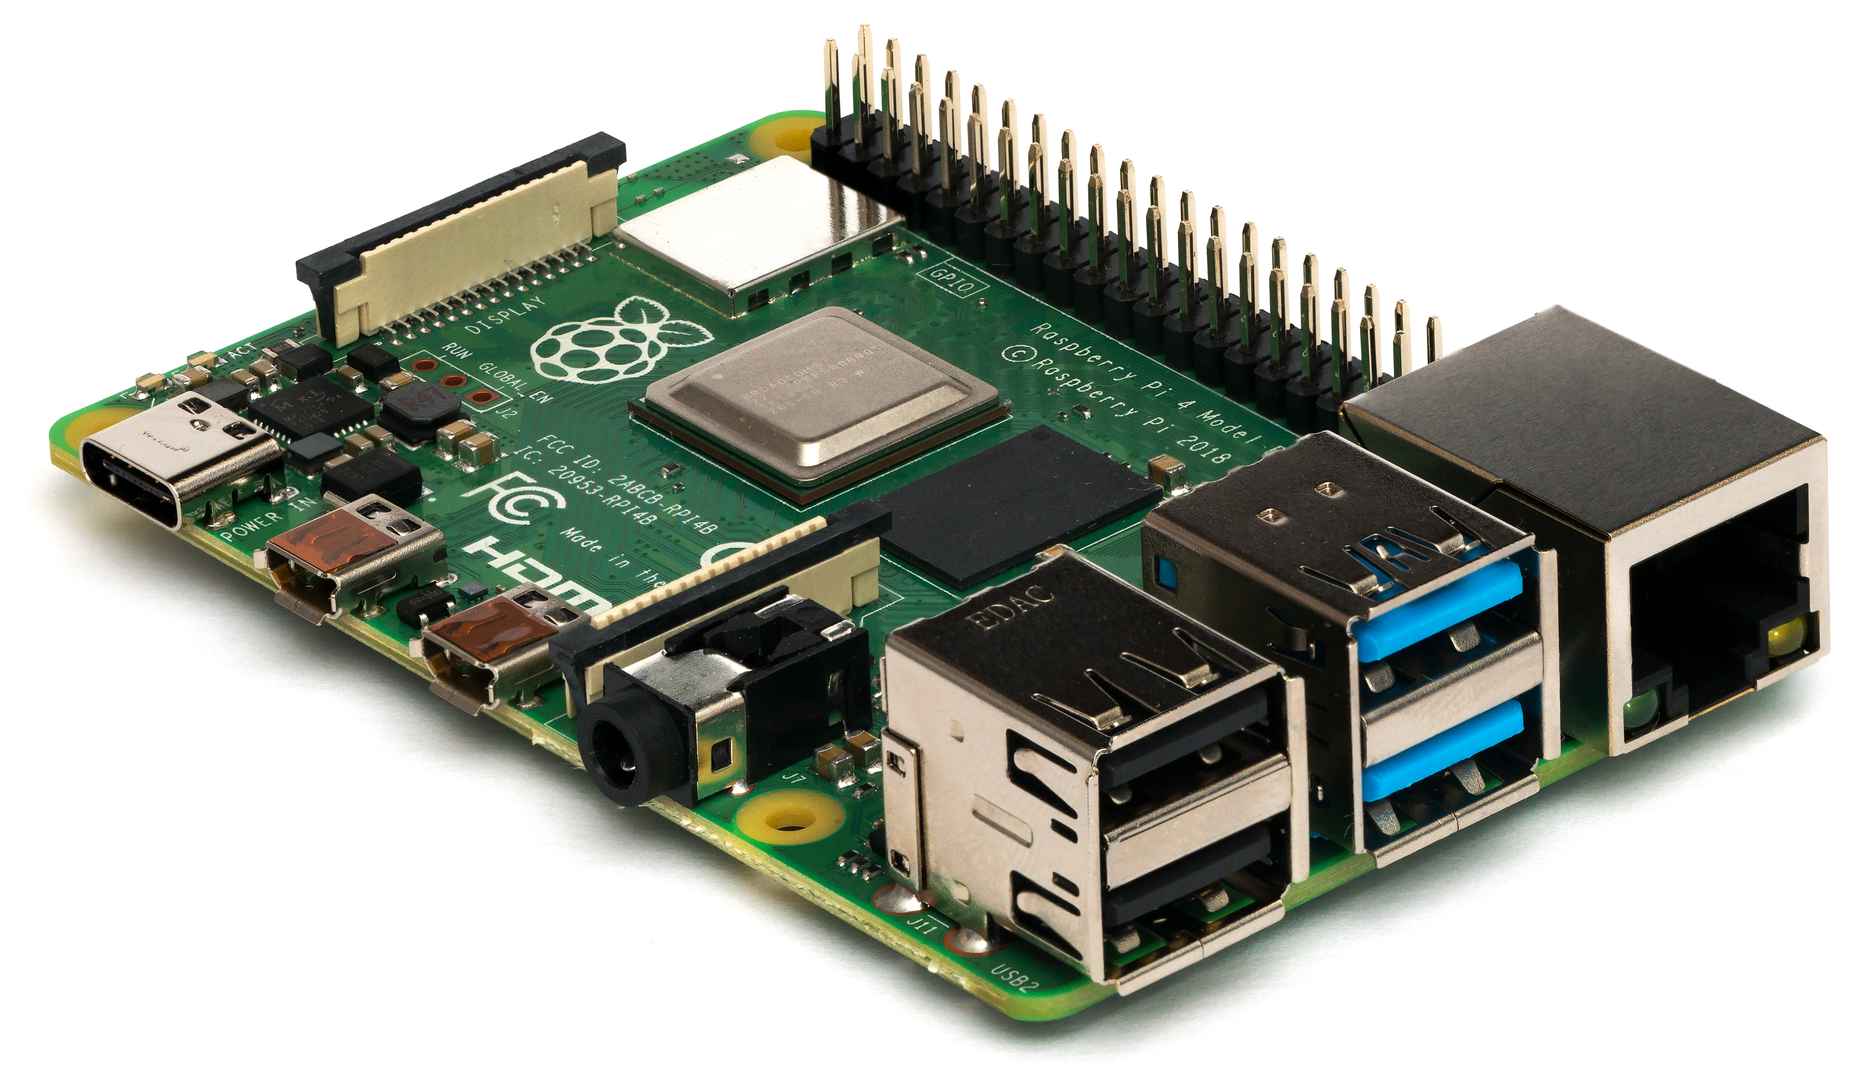

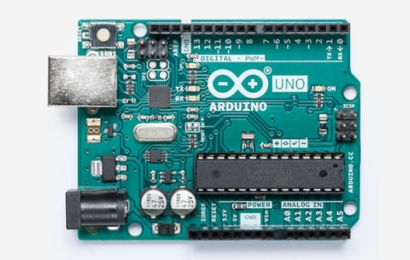
Connected by VNC
Input instructions
Serial Communication
Instructs bot and its components

Slide 4
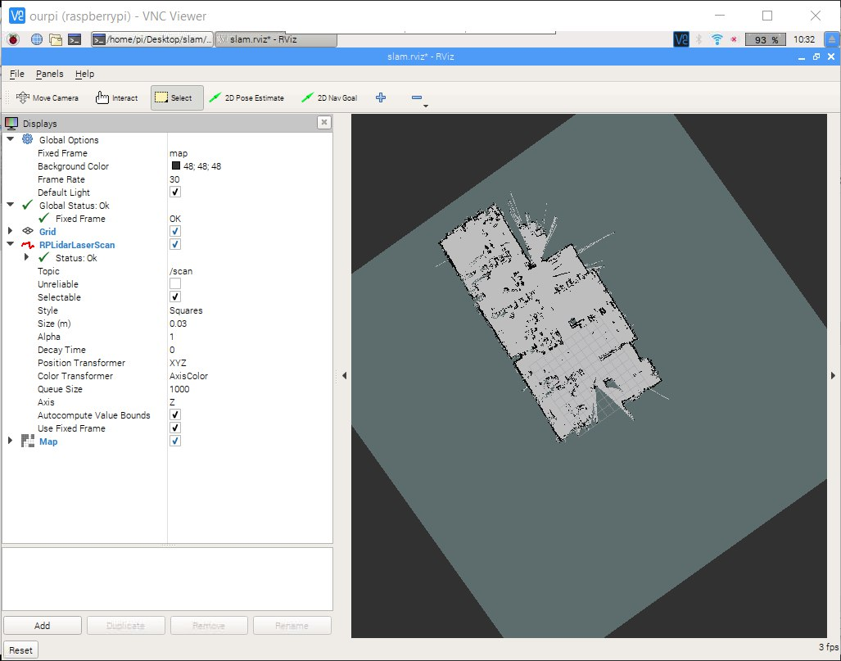
Instructs LIDAR to take readings
Returns readings
LIDAR data is transmitted to laptop to offload
Laptop runs Hector SLAM algorithm and visualization node

Slide 5
https://www.google.com/url?sa=i&url=https%3A%2F%2Fwww.asus.com%2FLaptops%2FASUS-Laptop-Series-Products%2F&psig=AOvVaw3W7i0jsn0mAMGCC_P-AqyA&ust=1584934699758000&source=images&cd=vfe&ved=0CA0QjhxqFwoTCJDXqImUregCFQAAAAAdAAAAABAD
https://www.google.com/imgres?imgurl=https%3A%2F%2Fupload.wikimedia.org%2Fwikipedia%2Fcommons%2Ff%2Ff1%2FRaspberry_Pi_4_Model_B_-_Side.jpg&imgrefurl=https%3A%2F%2Fen.wikipedia.org%2Fwiki%2FRaspberry_Pi&tbnid=TJ4wJpZVMQHa7M&vet=12ahUKEwijjeuxla3oAhX5j0sFHXKqAoAQMygAegUIARCsAg..i&docid=DtHoUD5AlbtMeM&w=4187&h=2464&q=raspberry%20pi&ved=2ahUKEwijjeuxla3oAhX5j0sFHXKqAoAQMygAegUIARCsAg
https://www.google.com/url?sa=i&url=https%3A%2F%2Fstore.arduino.cc%2Fusa%2Farduino-uno-rev3&psig=AOvVaw3n1qUKV59rhifm4ZJqOXSK&ust=1584935755582000&source=images&cd=vfe&ved=0CAIQjRxqFwoTCKiB0fiXregCFQAAAAAdAAAAABAD

